Slide 1


Airbnb User First Booking Destination Prediction
Boya Chen, Shuyi Tan, Eva Loo

Slide 2

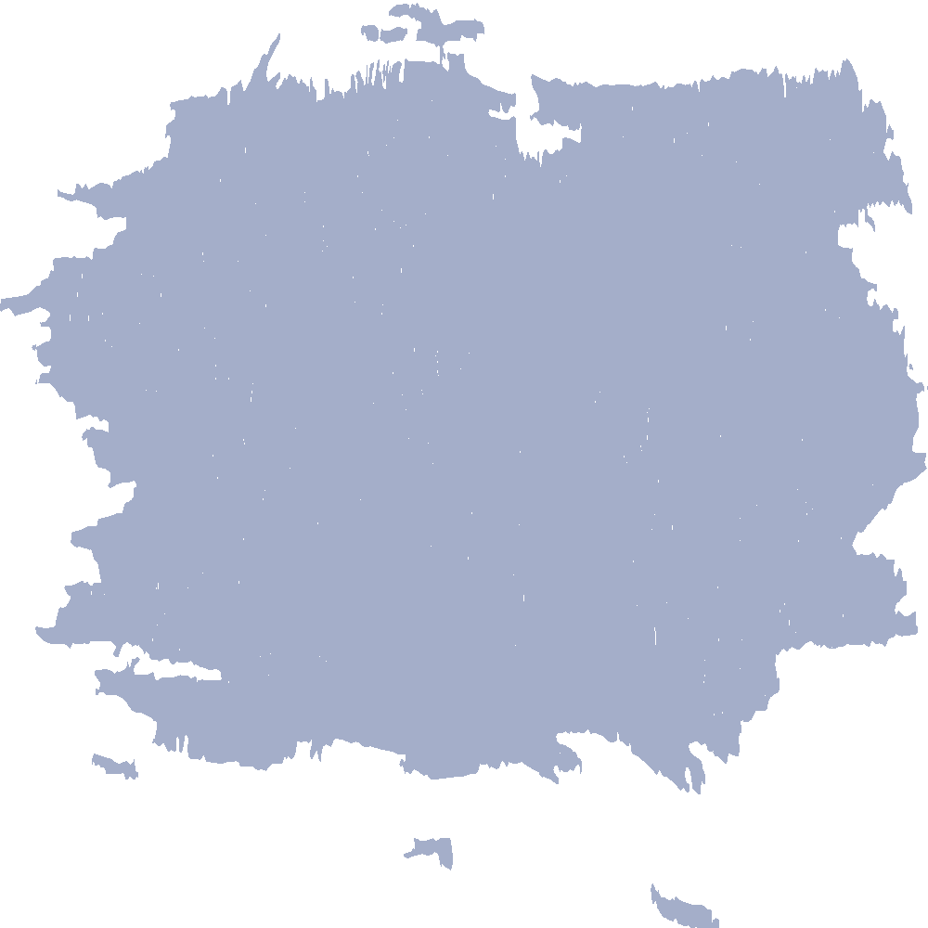
Data Recap
Contents
01
Data cleaning and transformation
Methodology
02
Statistical Models
Results
03
Accuracy & Model Selection
Variable Interpretation
04
Importance & Meanings
Conclusion
05
Summary & Future Steps

Slide 3
| Data cleaning and transformation|
Data Recap
PART.01

Slide 4
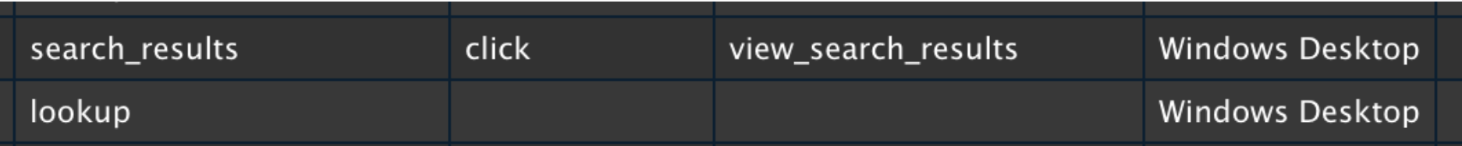
Datasets Overview
User
Session
Age
Gender
Browser type
Paid marketing
Date a user create an account
App used for signup
.....
Action
Action type
Action Details
Device Type
Second Elapsed

Slide 5
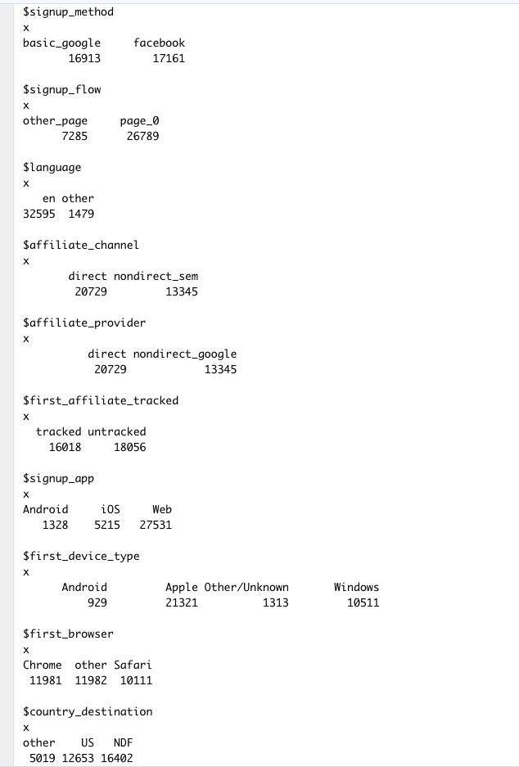
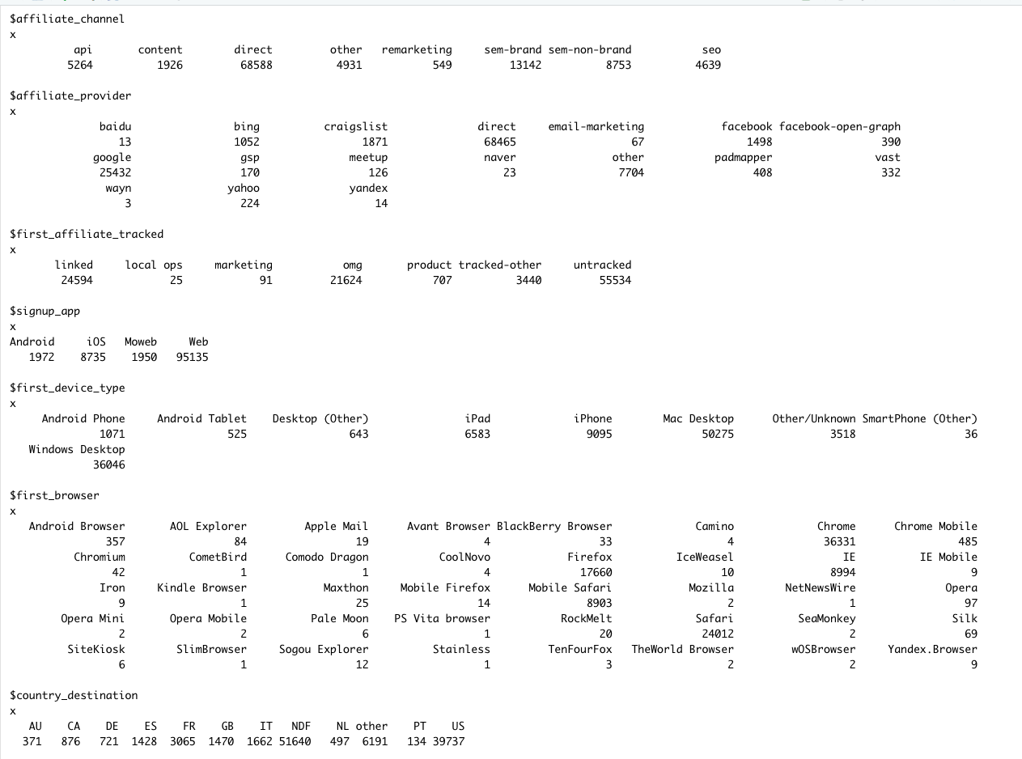
User Further Cleaning
Post-merged
Pre-merged

Slide 6
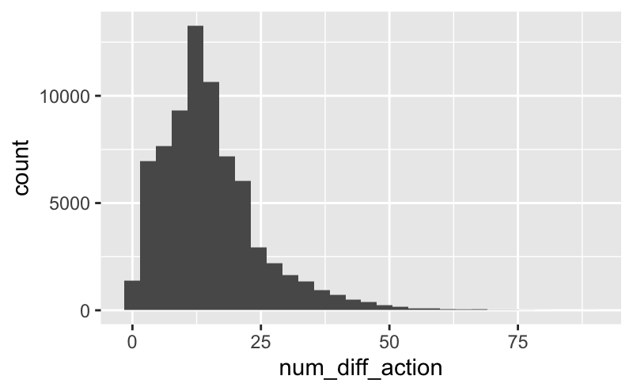
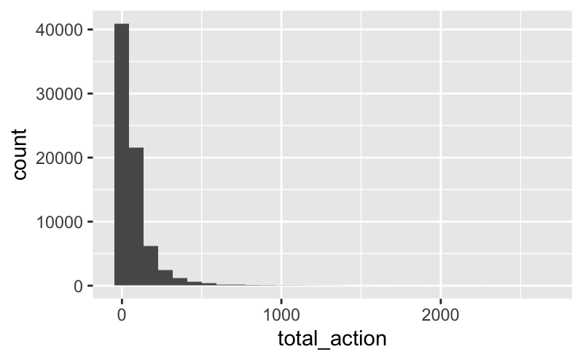
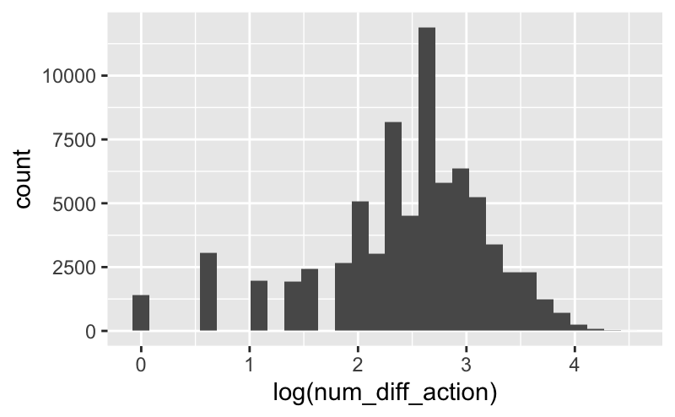
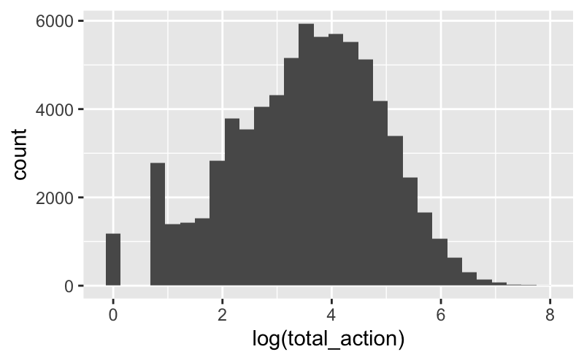
Session Recleaning
Action, Action Type, Action Detail
Action Triplet
Still group three action predictors together
The number of unique action triplets each user performed is calculated
The number of total actions each user performed is calculated
Use log transformation for both variables

Slide 7
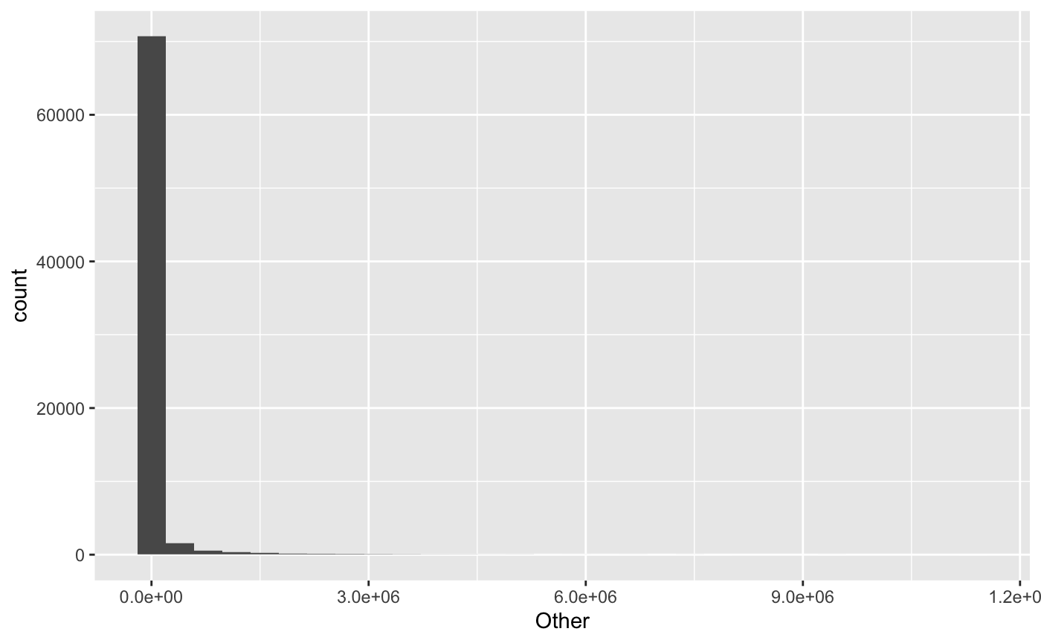
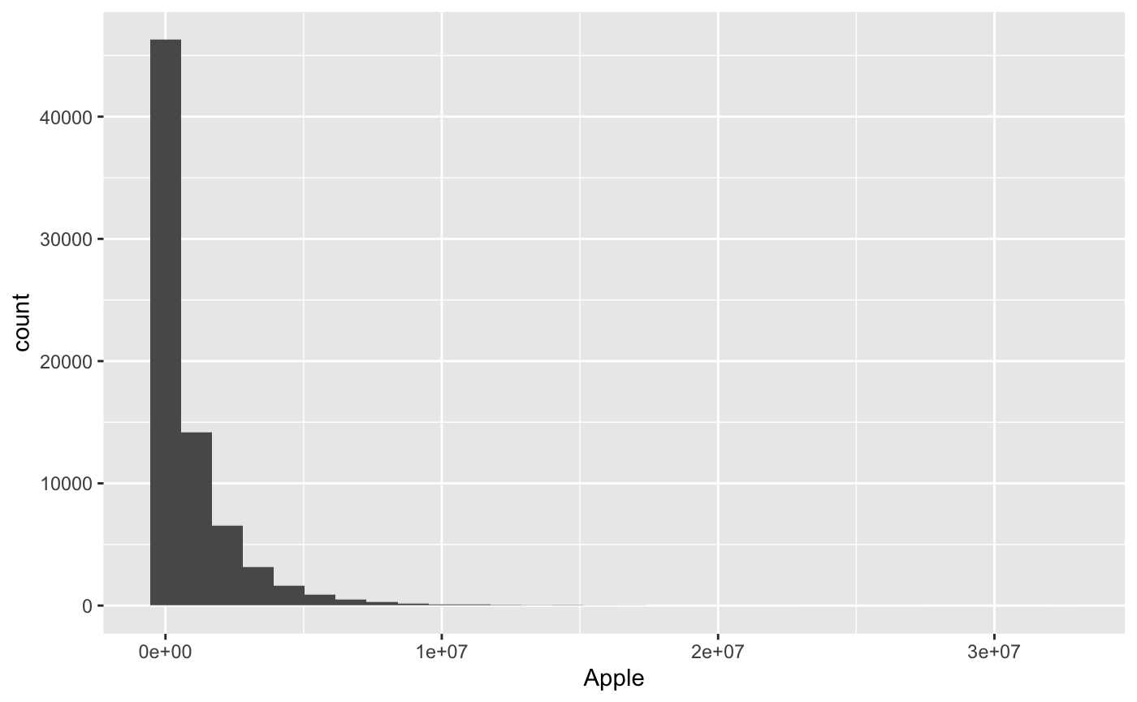
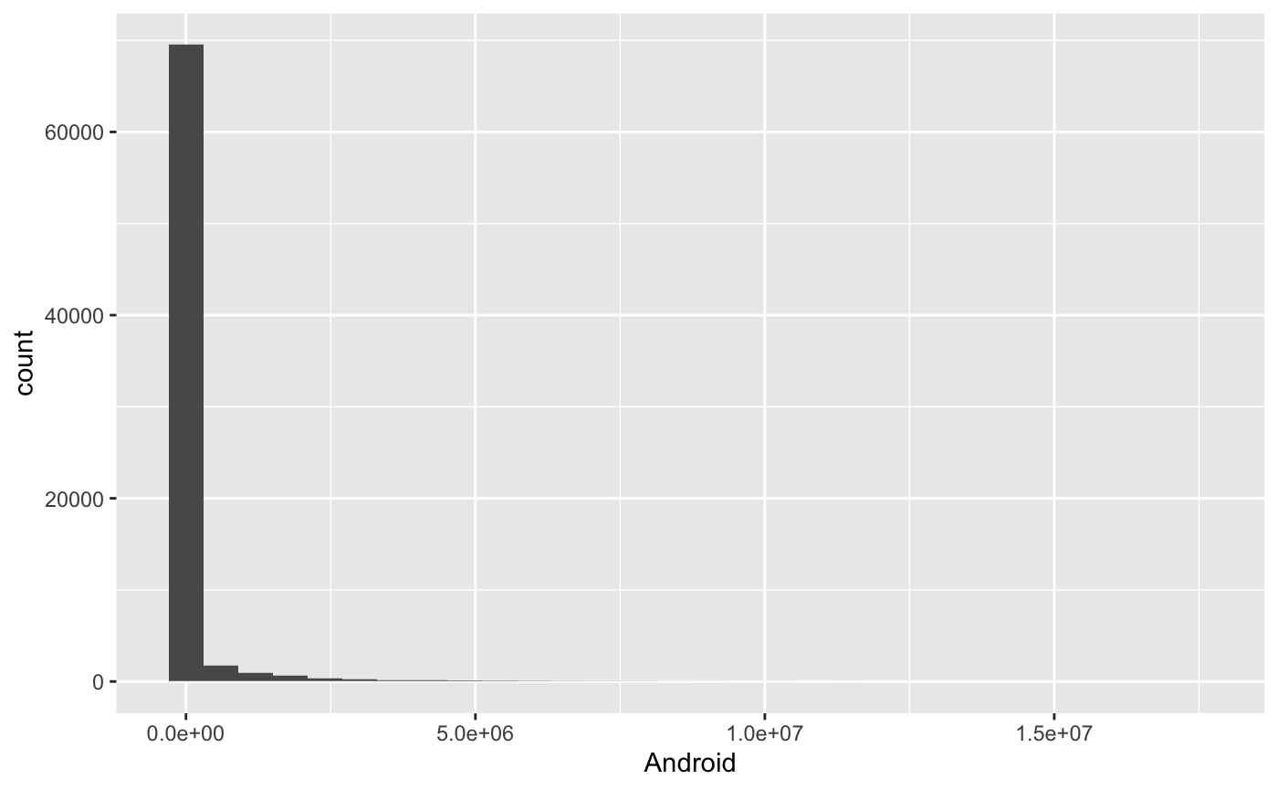
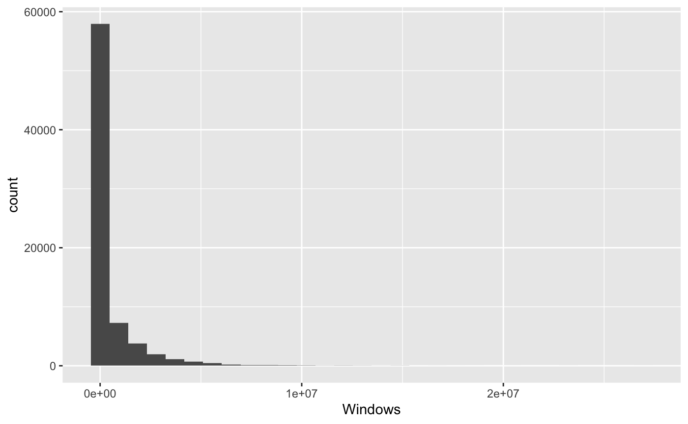
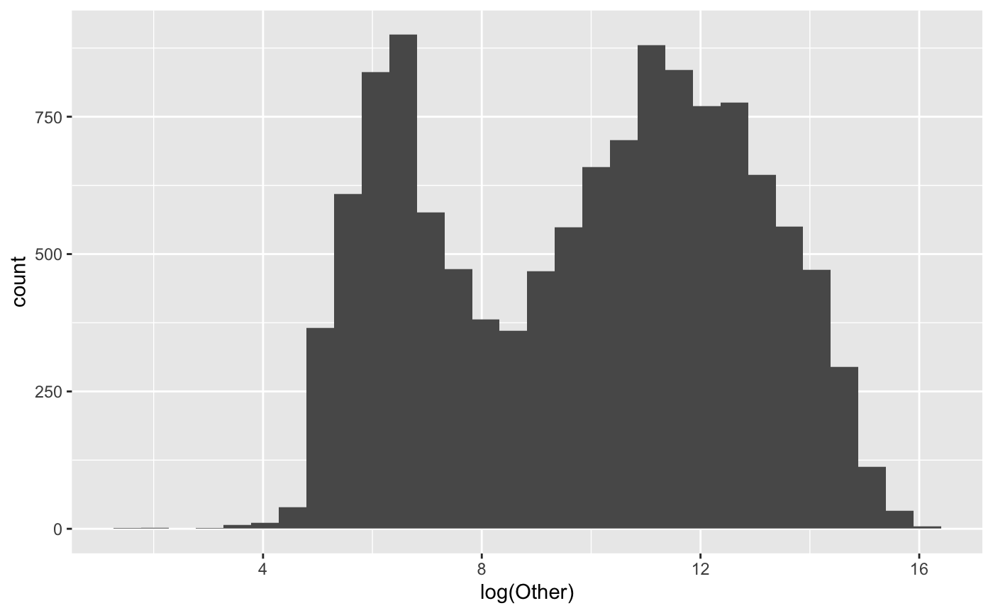
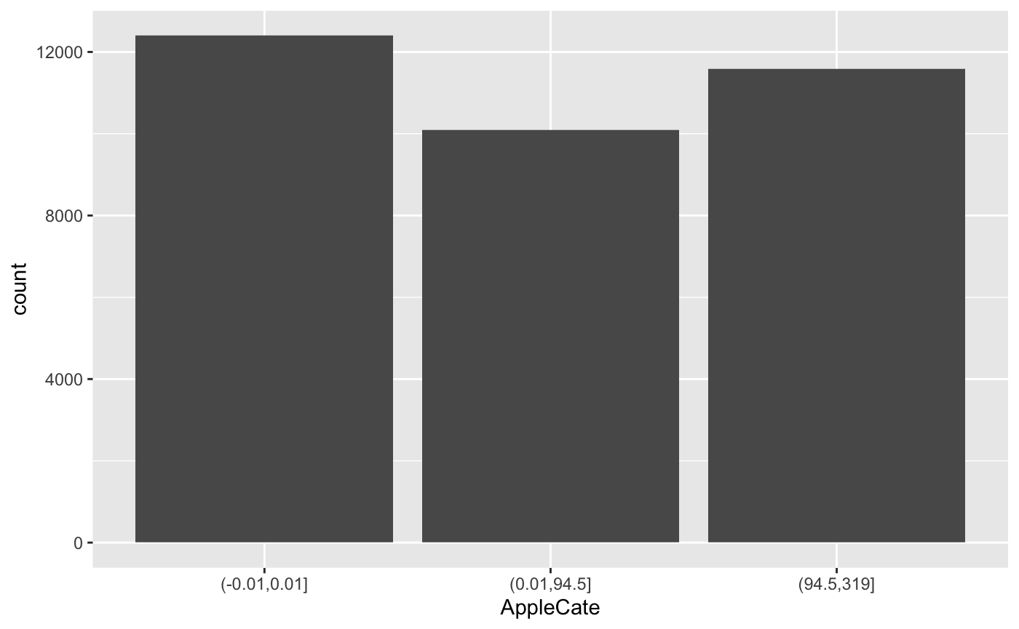
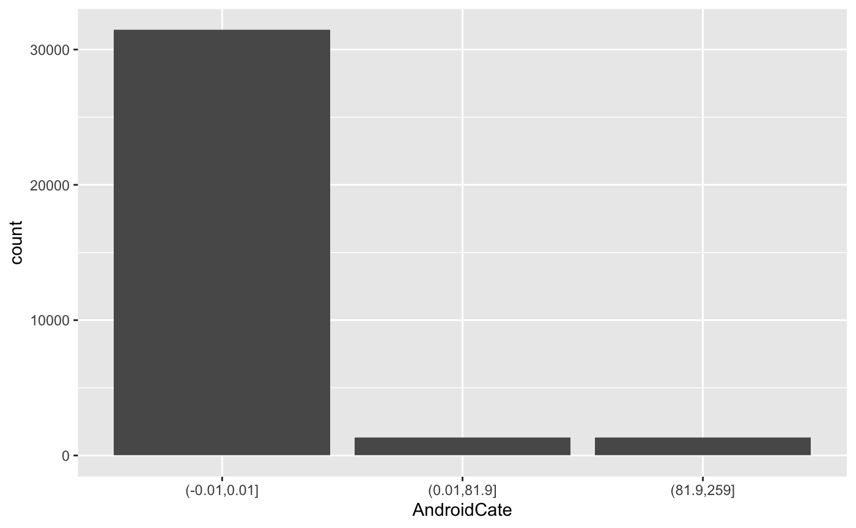
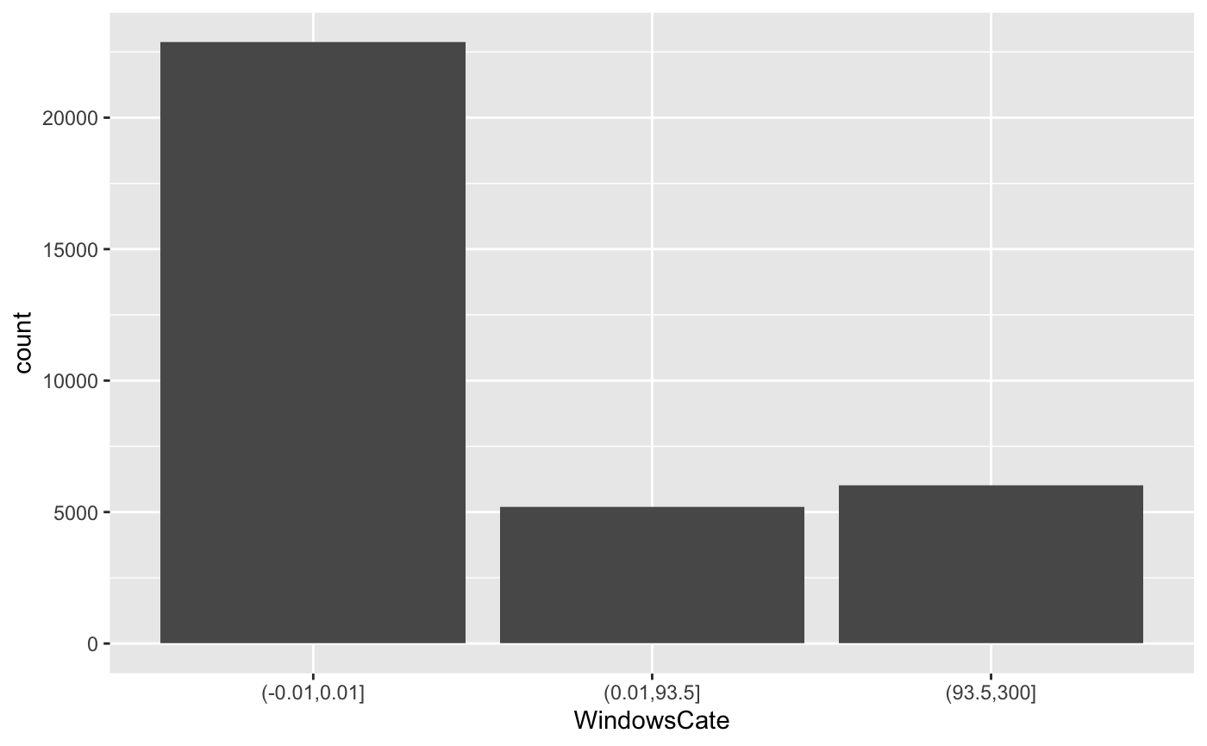
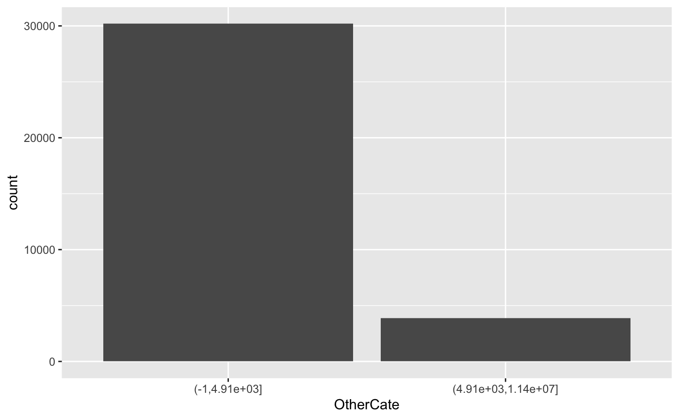
Session Recleaning
Device Type, Time Elapsed
Devices & Time Elapsed
Merge device types into four main categories: Apple, Android, Windows, Other.
One hot encode the device type and input the 1s by the total time each user spend on this device.
Bin all four categories.
Other first take log than bin,
We tried many transformations, but none of them seem to solve the “too many 0” problem.
We are open to any suggestion!

Slide 8
Brief Summary of Data Cleaning
User Dataset
Session Dataset
Session Dataset
Given that not all user in the user dataset has corresponding session data
Inner join the user and session dataset
Observations reduce from 213,451 to 34,074
Dates are transformed to number of days until 2015
Subclasses of categorical variables are merged or droped
Transformation are applied to continuous variable
Action and device data are encoded so that each user only have one line of data
Transformation and binning method are applied

Slide 9
| Statistical Models |
Methodology
PART.02

Slide 10
Modeling
Feature Selection, Comparison within One Model, Model Selection
Feature Selection
01
Test of correlation
Recursive feature selection
Training Models in Different Ways
02
Fitting
Full model
Model with a subset of variables
Model after undersampling and oversampling
Comparison of Models’ Out-of-sample Prediction
03
Misclassification rate based on
50% Prediction interval
80% Prediction interval
AUC value

Slide 11
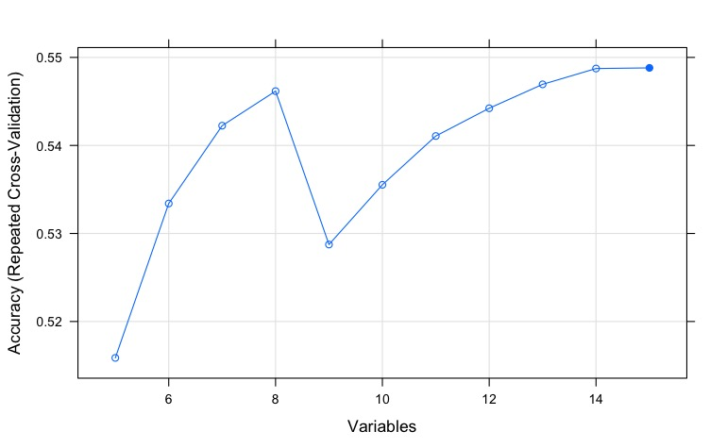
Feature Selection
Recursive Feature Elimination
Test of Independence
Using Fold 1 (holdout) as an example.
Input data would the corresponding training folds (fold 2 to 5)
Model with the remaining 15 predictors yield highest accuracy
Chi- Square Test
 | Signup_method | Signup_app | signup_flow
Signup_method | 0
Signup_app | < 2.2e-16 | 0
signup_flow | < 2.2e-16 | < 2.2e-16 | 0
 | Affiliate Channel | Affiliate Provider | First Affiliate Tracked
Affiliate Channel | 0
Affiliate Provider | < 2.2e-16 | 0
First Affiliate Tracked | < 2.2e-16 | < 2.2e-16 | 0

Slide 12
Models
Models we used
I
II
III
Naive Bayes
Random Forest
Multinomial Logit Model

Slide 13
| Accuracy & Model Selection |
Results
PART.03

Slide 14
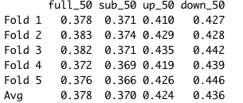
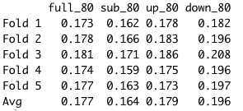
Naive Bayes
Compare Misclassification Rate for 50% and 80% prediction interval
Comparing all four models, the subsetted model has the best performance
Resampling did not improve the performance

Slide 15
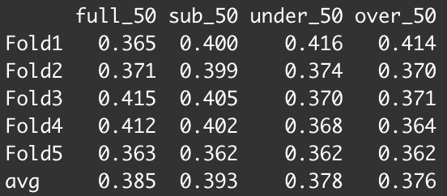
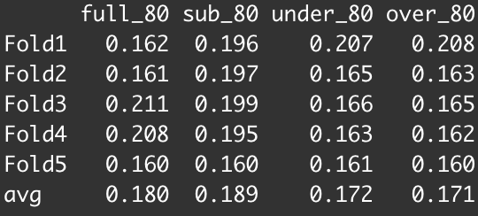
Random Forest
Compare Misclassification Rate for 50% and 80% prediction interval
Number of random variables used in each split, mtry is tuned using the OOB error rate right before fitting training the model
Comparing all four models, oversampling seems to work the best.
** 3 digits is used here as 2 digits cannot distinguish between undersampling and oversampling

Slide 16
 | full_50 | sub_50 | under_50 | over_50
Fold 1 | 0.317 | 0.322 | 0.287 | 0.282
Fold 2 | 0.321 | 0.327 | 0.280 | 0.286
Fold 3 | 0.320 | 0.320 | 0.287 | 0.290
Fold 4 | 0.318 | 0.328 | 0.287 | 0.283
Fold 5 | 0.317 | 0.313 | 0.317 | 0.287
Avg | 0.317 | 0.322 | 0.287 | 0.282
Multinomial Logistic Regression
Compare Misclassification Rate for 50% and 80% prediction interval
Reference level — “NDF”
Full model (5th fold) was used to determine features of the subsetted model
Improved classification rate in oversampling and undersampling model
In general, Oversampling model is deemed to be the best model in multinomial logistic regression
Note: stepwise AIC was used to aid in variable selection, however, the AIC value only differs to the full models’ by 3.65
 | full_80 | sub_80 | under_80 | over_80
Fold 1 | 0.110 | 0.109 | 0.078 | 0.073
Fold 2 | 0.108 | 0.108 | 0.073 | 0.079
Fold 3 | 0.108 | 0.108 | 0.077 | 0.079
Fold 4 | 0.107 | 0.108 | 0.085 | 0.070
Fold 5 | 0.109 | 0.109 | 0.109 | 0.081
Avg | 0.110 | 0.109 | 0.078 | 0.073

Slide 17
Model Selection Accuracy
Select the best model
50% | Naive Bayes | Random Forest | Multinomial
Fold 1 | 0.37 | 0.41 | 0.28
Fold 2 | 0.37 | 0.37 | 0.29
Fold 3 | 0.37 | 0.37 | 0.29
Fold 4 | 0.37 | 0.36 | 0.28
Fold 5 | 0.37 | 0.36 | 0.29
Avg | 0.37 | 0.38 | 0.28
80% | Naive Bayes | Random Forest | Multinomial
Fold 1 | 0.16 | 0.21 | 0.07
Fold 2 | 0.17 | 0.16 | 0.08
Fold 3 | 0.17 | 0.16 | 0.08
Fold 4 | 0.16 | 0.16 | 0.07
Fold 5 | 0.16 | 0.16 | 0.08
Avg | 0.16 | 0.17 | 0.07

Slide 18
Model Selection AUC
Select the best model
 | Naive Bayes | Random Forest | Multinomial Logit
Fold 1 | 0.61 | 0.51 | 0.64
Fold 2 | 0.60 | 0.51 | 0.63
Fold 3 | 0.60 | 0.54 | 0.63
Fold 4 | 0.61 | 0.50 | 0.64
Fold 5 | 0.60 | 0.51 | 0.62
Avg | 0.61 | 0.51 | 0.64

Slide 19
| Variable Importance and Meanings |
Variable Interpretation
PART.04

Slide 20
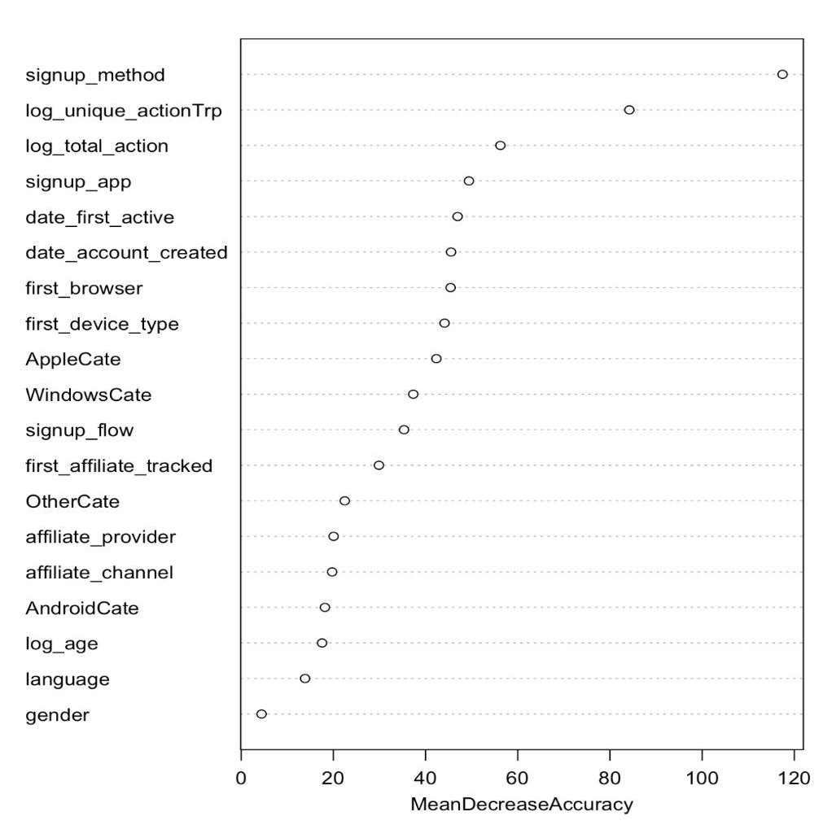
Variable Importance
Random Forest
(signup_method) People who sign up through googling airbnb are more likely to make a booking than those who saw an advertisement on facebook.
(Log_unique_actionTrp & Log_total_action) The more unique actions the user performs, the more serious the user is about the booking, thereby, more likely to make a booking.
(date_first_active & date_account_created) People who want to make a booking usually make a final decision sooner after they sign up.
Note that all three signup method are pretty significant, that could explain why in random forest method, the full model performs better than the subsetted model.
(We are still trying to figure this out, any suggestion from the class will be much appreciated)

Slide 21
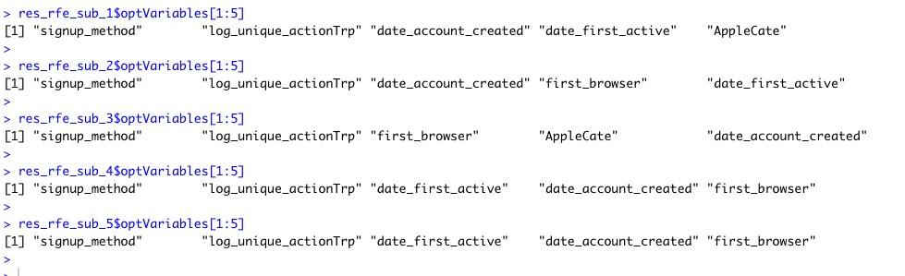
Recursive Feature Elimination
Two predictors that are different from variable importance (Red)
(First_browser) People who use a computer to browse through the website is more serious about choosing the right room than those who uses phone or tablet.
(AppleCate) Back in 2014 and 2015, Apple’s camera quality is one of the best among other smartphones, so people who love to travel may tend to such device.

Slide 22
| Summary & Future Steps |
In general, multinomial logit model performs the best with the highest out-of-sample prediction accuracy and AUC values
Conclusion
PART.05

Slide 23
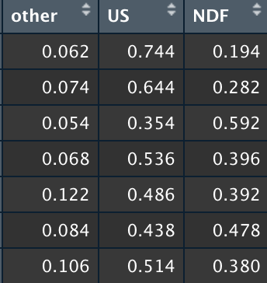
Ideas for Self-defined Interval Score for Classification
Using the first observation of prediction probabilities as an example.
Assume US is the correct class.

Slide 24
Airbnb Booking Prediction
Thank you !
Boya Chen, Shuyi Tan, Eva Loo

Slide 25
年中工作概述
Review of work content
标题文本
标题文本
标题文本
标题文本
单击此处可编辑内容，单击此处可编辑内容，单击添加项目内容。
单击此处可编辑内容，单击此处可编辑内容，单击添加项目内容。
单击此处可编辑内容，单击此处可编辑内容，单击添加项目内容。
单击此处可编辑内容，单击此处可编辑内容，单击添加项目内容。
您的内容打在这里，或者通过复制您的文本后，在此框中选择粘贴，并选择只保留文字。您的内容打在这里，或者通过复制您的文本后，在此框中选择粘贴，并选择只保留文字。您的内容打在这里，或者通过复制您的文本后，在此框中选择粘贴，并选择只保留文字。

Slide 26

市场状况概述
Overview of market conditions
您的内容打在这里，或者通过复制您的文本后，在此框中选择粘贴，并选择只保留文字。
您的内容打在这里，或者通过复制您的文本后，在此框中选择粘贴，并选择只保留文字。您的内容打在这里，或者通过复制您的文本后，在此框中选择粘贴，并选择只保留文字。您的内容打在这里，或者通过复制您的文本后，在此框中选择粘贴，并选择只保留文字。
标题文字
您的内容打在这里，或者通过复制您的文本后，在此框中选择粘贴，并选择只保留文字。您的内容打在这里，或者通过复制您的文本后，在此框中选择粘贴，并选择只保留文字。

Slide 27
市场状况概述
Overview of market conditions
63%
40%
80%
92%
标题文字添加
标题文字添加
标题文字添加
标题文字添加
单击此处可编辑内容，根据您的需要自由拉伸文本框大小，建议使用微软雅黑。
单击此处可编辑内容，根据您的需要自由拉伸文本框大小，建议使用微软雅黑。
单击此处可编辑内容，根据您的需要自由拉伸文本框大小，建议使用微软雅黑。
单击此处可编辑内容，根据您的需要自由拉伸文本框大小，建议使用微软雅黑。

Slide 28
标题文字
您的内容打在这里，或者通过复制您的文本后，在此框中选择粘贴，并选择只保留文字。
年中工作概述
Review of work content
标题文字
您的内容打在这里，或者通过复制您的文本后，在此框中选择粘贴，并选择只保留文字。
您的内容打在这里，或者通过复制您的文本后，在此框中选择粘贴，并选择只保留文字。您的内容打在这里，或者通过复制您的文本后，在此框中选择粘贴，并选择只保留文字。您的内容打在这里，或者通过复制您的文本后，在此框中选择粘贴，并选择只保留文字。
标题文字
您的内容打在这里，或者通过复制您的文本后，在此框中选择粘贴，并选择只保留文字。

Slide 29

工作目标计划
Annual work plan
标题文字
您的内容打在这里，或者通过复制您的文本后，在此框中选择粘贴，并选择只保留文字。
标题文字
您的内容打在这里，或者通过复制您的文本后，在此框中选择粘贴，并选择只保留文字。
标题文字
您的内容打在这里，或者通过复制您的文本后，在此框中选择粘贴，并选择只保留文字。

Slide 30
工作目标计划
Annual work plan
标题文字
标题文字
您的内容打在这里，或者通过复制您的文本后，在此框中选择粘贴，并选择只保留文字。
您的内容打在这里，或者通过复制您的文本后，在此框中选择粘贴，并选择只保留文字。
标题文字
标题文字
您的内容打在这里，或者通过复制您的文本后，在此框中选择粘贴，并选择只保留文字。
您的内容打在这里，或者通过复制您的文本后，在此框中选择粘贴，并选择只保留文字。

Slide 31

工作目标计划
Annual work plan
您的内容打在这里，或者通过复制您的文本后，在此框中选择粘贴，并选择只保留文字。您的内容打在这里，或者通过复制您的文本后，在此框中选择粘贴，并选择只保留文字。您的内容打在这里，或者通过复制您的文本后，在此框中选择粘贴，并选择只保留文字。
标题文字
标题文字
您的内容打在这里，或者通过复制您的文本后，在此框中选择粘贴，并选择只保留文字。
您的内容打在这里，或者通过复制您的文本后，在此框中选择粘贴，并选择只保留文字。

